Slide 1

AWS step functions

Slide 2
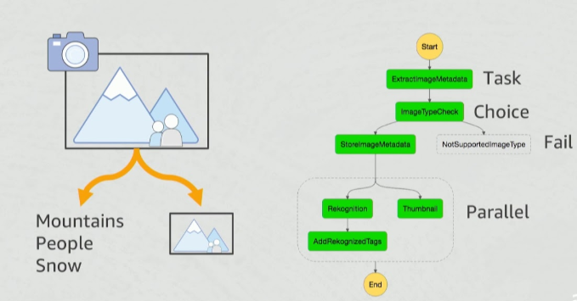
Aws step function solutions

Slide 3
Aws step function solutions
Based on the concepts of tasks and state machines.
Define state machines using the JSON-based Amazon States Language.
Get a graphical view of your state machine's structure. This provides a way to visually check your state machine's logic and monitor executions.

Slide 4
Types of step functions
 | Standard Workflows | Express Workflows
Maximum duration | 1 year. | 5 minutes.
Supported execution start rate | Over 2,000 per second | Over 100,000 per second
Supported state transition rate | Over 4,000 per second per account | Nearly unlimited
Pricing | Priced per state transition. A state transition is counted each time a step in your execution is completed. | Priced by the number of executions you run, their duration, and memory consumption.
Execution history | Executions can be listed and described with Step Functions APIs, and visually debugged through the console. They can also be inspected in CloudWatch Logs by enabling logging on your state machine. | Executions can be inspected in CloudWatch Logs by enabling logging on your state machine.
Execution semantics | Exactly-once workflow execution. | At-least-once workflow execution.
Service integrations | Supports all service integrations and patterns. | Supports all service integrations. Does not support Job-run (.sync) or Callback (.waitForTaskToken) patterns.
Step Functions activities | Supports Step Functions activities. | Does not support Step Functions activities.

Slide 5
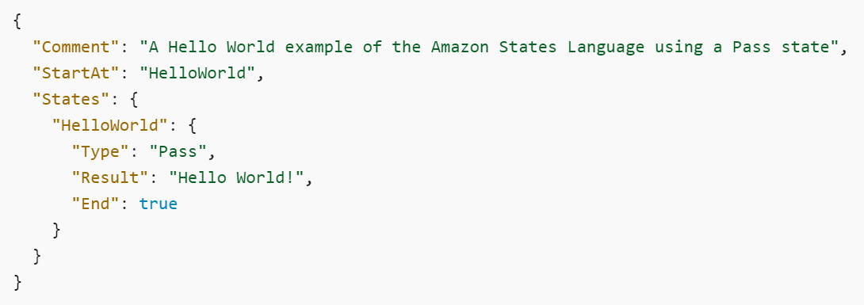
states
https://docs.aws.amazon.com/step-functions/latest/dg/concepts-amazon-states-language.html

Slide 6
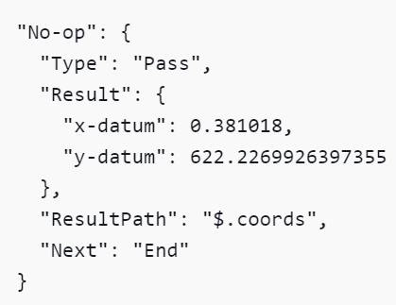
Pass states
Passes input to the output without performing any task.
Useful for debugging

Slide 7
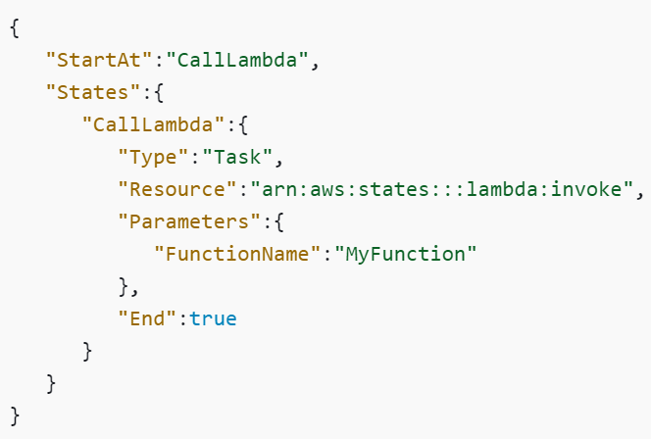
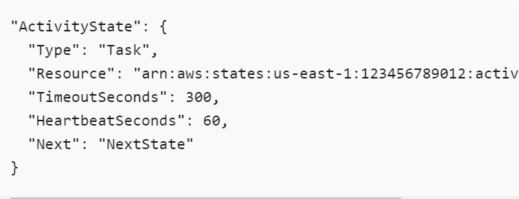
Task states
Call a task and then trigger the parameters and then wait to get its output

Slide 8
choice states
Check the condition and branch to the next state based on the condition
https://docs.aws.amazon.com/step-functions/latest/dg/amazon-states-language-choice-state.html
And
BooleanEquals
Not
NumericEquals
NumericGreaterThan
NumericGreaterThanEquals
NumericLessThan
NumericLessThanEquals
Or
StringEquals
StringGreaterThan
StringGreaterThanEquals
StringLessThan
StringLessThanEquals
TimestampEquals
TimestampGreaterThan
TimestampGreaterThanEquals
TimestampLessThan
TimestampLessThanEquals

Slide 9
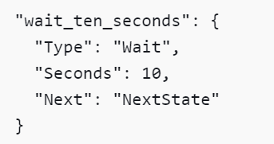
WAIT CONDITION
Wait for some prespecified time before going to the next state
https://docs.aws.amazon.com/step-functions/latest/dg/amazon-states-language-choice-state.html

Slide 10
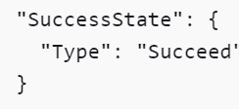
succeed
Successful completion of the step function
https://docs.aws.amazon.com/step-functions/latest/dg/amazon-states-language-choice-state.html

Slide 11
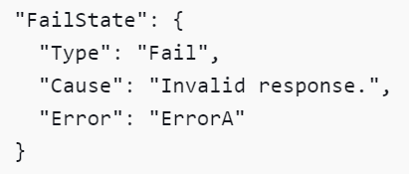
Fail state
Failure of the completion of the jobs
https://docs.aws.amazon.com/step-functions/latest/dg/amazon-states-language-choice-state.html

Slide 12
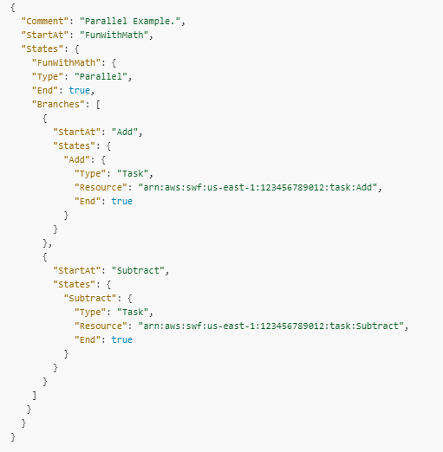
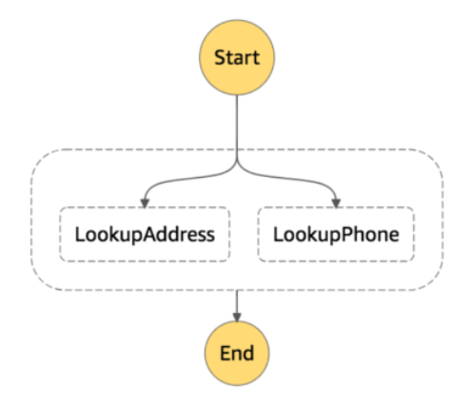
parallel condition
Parallel execution of the jobs
https://docs.aws.amazon.com/step-functions/latest/dg/amazon-states-language-parallel-state.html

Slide 13
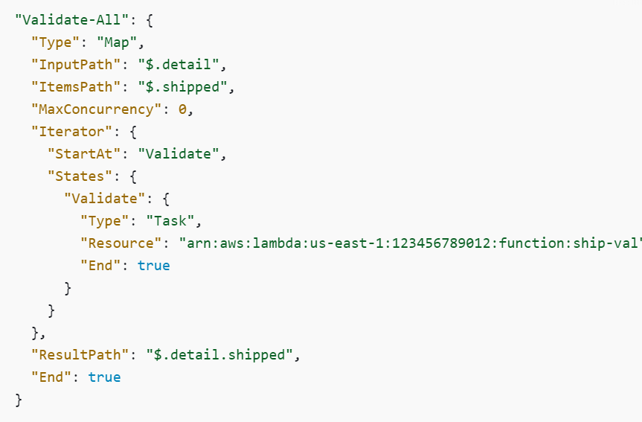
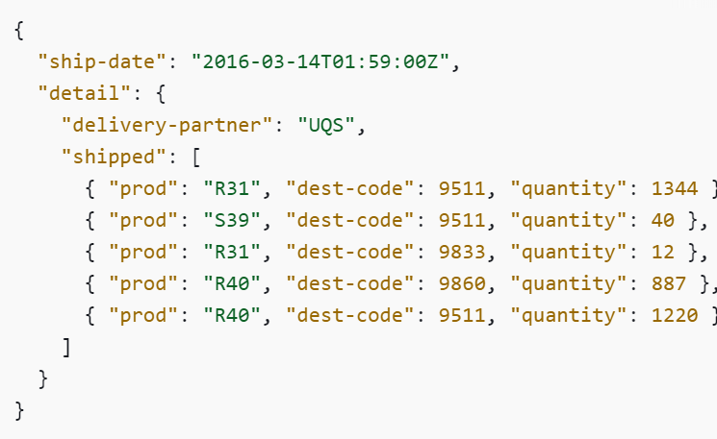
Map state
Run set of steps in each element in the array
Run same step in all the multiple entries in the array

